Slide 1
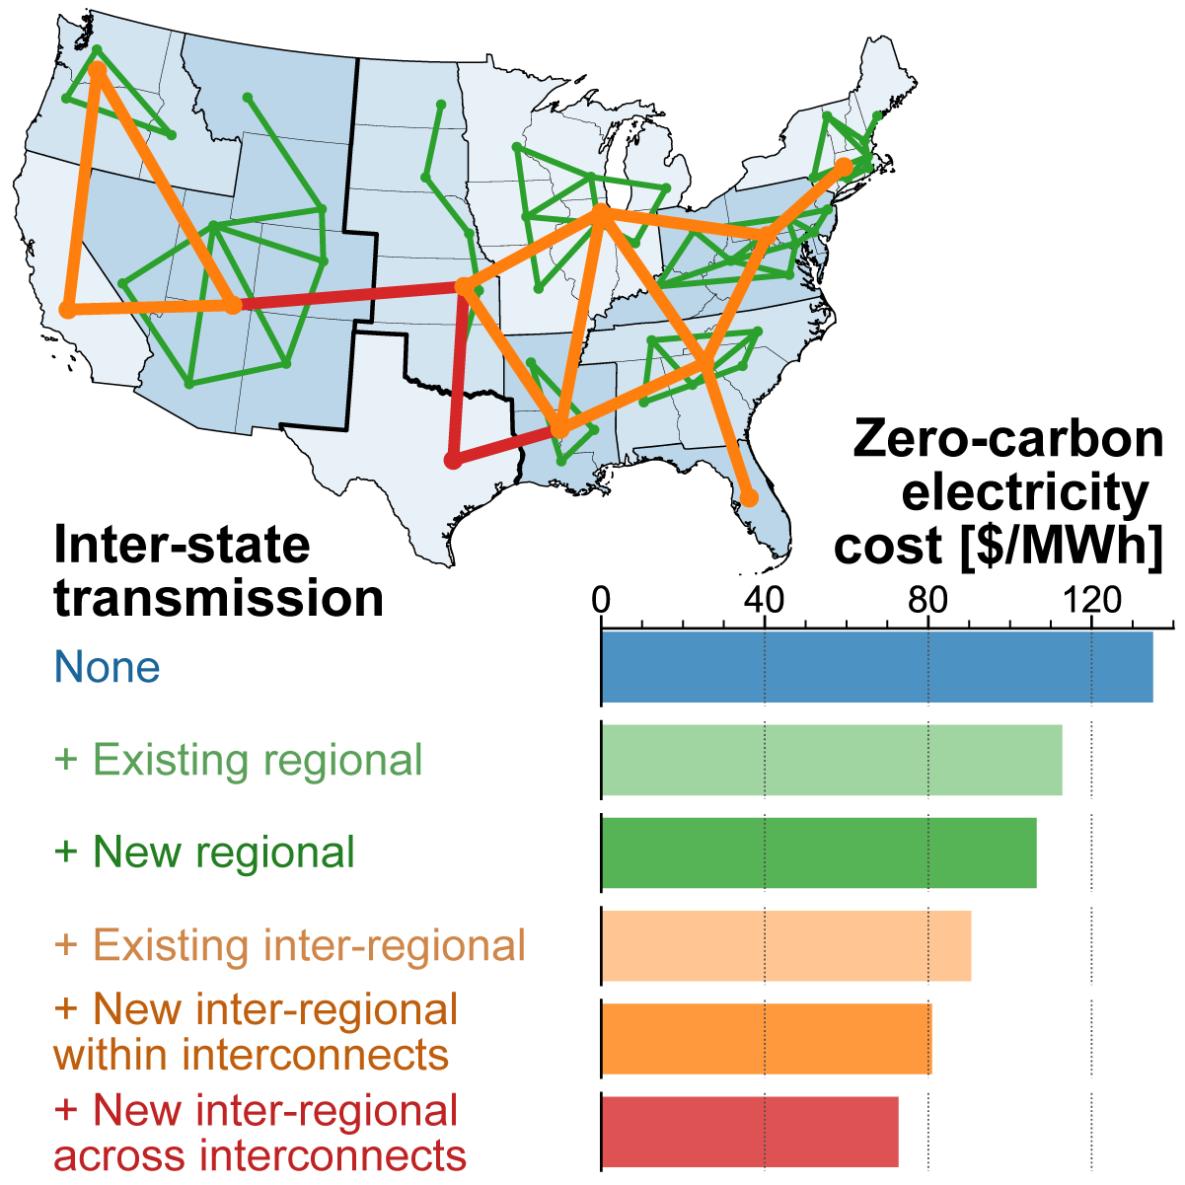

The value of interregional coordination and transmission in decarbonizing the US electricity system
Patrick R. Brown
NARUC Task Force on Electric Transmission
2022-07-08
Brown, P.R.; Botterud, A. Joule 2021, 5, 115
https://doi.org/10.1016/j.joule.2020.11.013
https://github.com/patrickbrown4/zephyr
prbrown@mit.edu
Notes:
High-level tradeoffs between transmission, storage, and different generation types

Slide 2
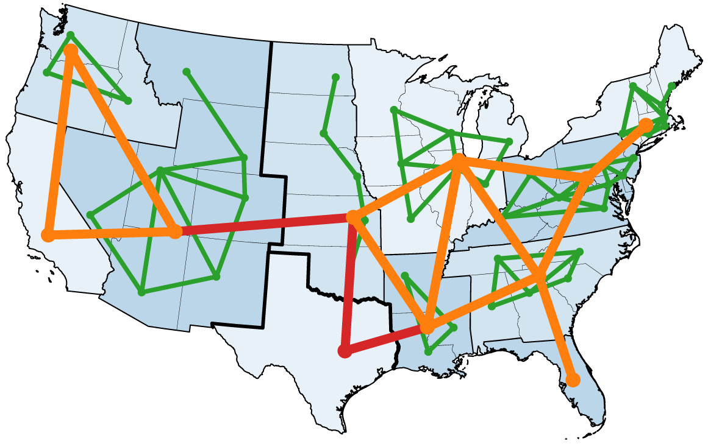
This study: VRE + transmission + storage
ZEPHYR:
Zero-emissions
Electricity system
Planning with
HourlY operational
Resolution
Brown, P.R.; Botterud, A. Joule 2021, 5, 115 https://doi.org/10.1016/j.joule.2020.11.013
https://github.com/patrickbrown4/zephyr
Co-optimized capacity & operation of generation, storage, and transmission
7 years of 8760-hour weather (2007–2013)
8760-hour demand from NREL Electrification Futures Study
100k’s of wind/solar sites
3 geographic scopes: states, planning areas (PAs), integrated US
Base case includes zero-carbon technologies currently being deployed at GW scale in the US:
PV
Wind
Li-ion batteries
Existing hydro
Notes:
We use a custom-built model with, as is tradition, a somewhat forced acronym: “ZEPHYR” - Zero-emissions Electricity system Planning with HourlY operational Resolution.
ZEPHYR co-optimizes the capacity and operation of generation, storage, and interregional transmission using 7 years (61296 hours ) of hourly weather & load data.
Throughout the talk I’ll discuss results modeled at 3 different geographic scopes:
individual states, 11 ”planning areas” (PAs) (shown here as different shades of blue, roughly based on ISO boundaries), and an interconnected US system.
This didn’t actually start as a transmission study – our primary motivation was to explore what it would look like to decarbonize US electricity using technologies currently being deployed in the US at GW scale.
Given that we need to decarbonize electricity within 15-20 years to avoid the worst effects of climate change, that's not a lot of time to develop new technologies and ramp up production to GW scale.
That's not to say that we shouldn't work on new technologies, but it's risky to plan on them being available.
That leaves us with a pretty small collection of technologies: PV, wind, Li-ion batteries, and existing hydropower.
It turns out that if you’re confined to those technologies, transmission is very important.

Slide 3
Framing this work
¹ Denholm, P. et al., “The challenges of achieving a 100% renewable electricity system in the United States”, Joule 2021, 5, 1331
This study is:
This study is NOT:
Primarily concerned with resource adequacy in zero-carbon systems (i.e. the “balancing challenge”¹)
Technologically conservative
Only techs currently deployed at GW scale
An improvement on previous studies:
Copper plate (Caldeira, Jacobson) → Explicit interregional transmission flows and capacity
Isolated regions (Princeton, Sepulveda, Ziegler) → Full interconnected US
1 year of weather data (Princeton, NREL Seams, Sepulveda) → 7 years in base case, 21 years in sensitivity
Seasonal timeslices (NREL ReEDS) → hourly co-optimized planning & dispatch
An optimal-power-flow, security-constrained dispatch, or stability study
Transmission flows are completely controllable and highly aggregated
A transmission/generation siting study
Aggregated generation & transmission
An analysis of specific policy or regulatory approaches
Economy-wide
We only model the electricity system (with high-electrification sensitivities)
A pathway study
System snapshot, 2040 demand; hydro and transmission are the only brownfield assets
Notes:
To help put this study in context:
* We're mostly concerned with resource adequacy in zero-carbon systems (what some call the “balancing challenge”),
* and we're technologically conservative.
* This study is primarily an improvement on a few features of previous studies:
where previous studies used copper-plate transmission, we explicitly resolve transmission capacity and flows;
where some studies look at isolated regions, we look at the interconnected US;
and where some studies consider a single weather year, we use hourly chronological resolution over 7 years to capture the combined capacity value of renewables and storage
To be clear on what we don’t do:
* We don't do optimal power flow, security-constrained dispatch, or stability analysis
* It’s not a siting study, as renewables profiles and transmission capacity are aggregated over large regions
* We model a simple zero-carbon standard, without looking at detailed regulatory approaches or cost-allocation
* We only focus on the electricity system
* And we don't model pathways; we model a snapshot of system conditions based on 2040 projected demand

Slide 4
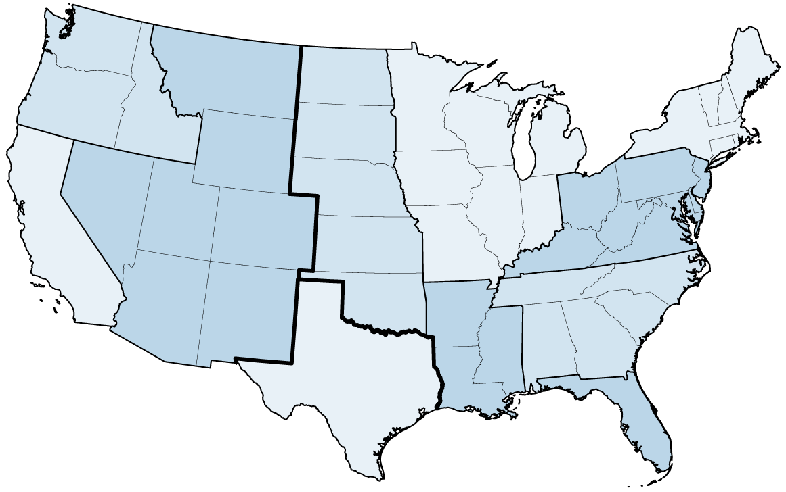
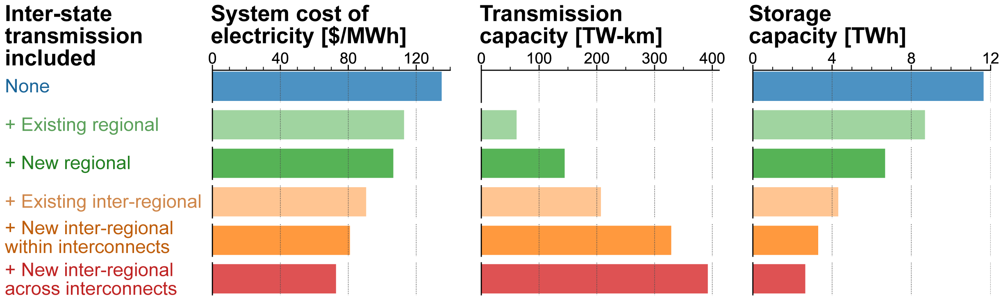
Transmission reduces system cost & storage requirements
Base case includes
zero-carbon technologies currently being deployed at GW scale in the US, along with existing hydro:
PV
Wind
Li-ion batteries
48% curtailment
~23 hours
Notes:
We start with isolated states, with no inter-state transmission, meaning every state has to balance supply and demand within its own borders.
On the left we show the system cost of electricity in $/MWh; in the middle is transmission capacity (zero in this very conservative every-state-for-itself case); on the right is storage capacity in TWh.
We see that each state can supply its hourly energy needs with wind and solar within its own borders, it’s just very expensive.

Slide 5
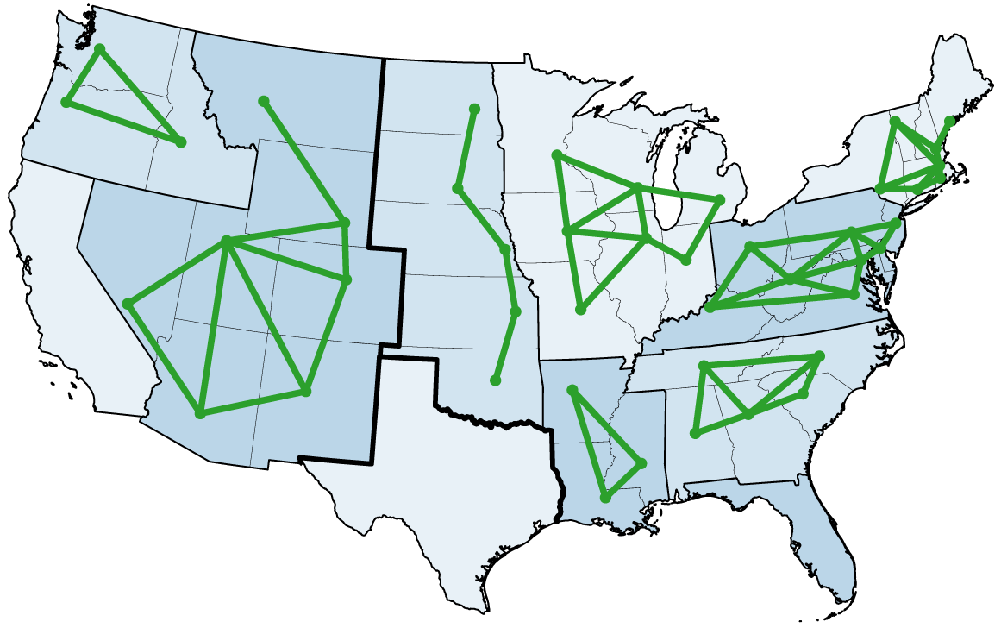
Transmission reduces system cost & storage requirements
48% curtailment
~23 hours
Notes:
A more realistic starting point would be if we balanced supply and demand at the planning-area level and used existing inter-state intra-PA transmission; in this case both electricity cost and storage capacity are reduced.
As we allow new transmission additions between states, the electricity cost reduces further.

Slide 6
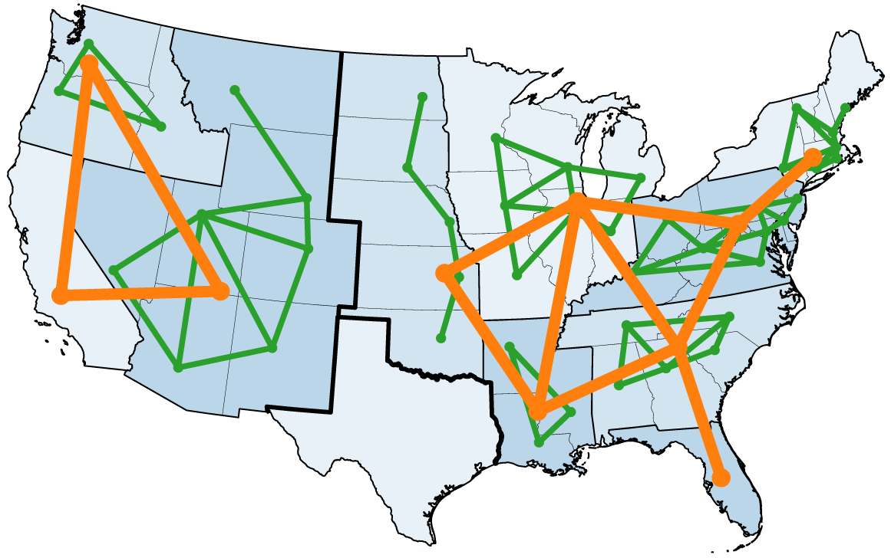
Transmission reduces system cost & storage requirements
48% curtailment
~23 hours
Notes:
As we move to the full integrated-US system, electricity costs and storage capacity continue to decline as additional transmission capacity is added.

Slide 7
Transmission reduces system cost & storage requirements
Is 36% curtailment a lot?
Peak/mean demand = 1.6
Capacity utilization in a completely dispatchable system is 1/1.6 = 63%
63% utilization = 37% “curtailment”
48% curtailment
~23 hours
36% curtailment
~5 hours
Notes:
Finally when we allow transmission additions between all planning areas, including between the three interconnects, we reach the lowest-cost system.
Today’s transmission system is about 150 TW-km, so this is about a 2.6x today’s system.
Wind and solar curtailment declines from around 48% in the isolated-states case to 36%, and storage capacity declines from about a day of average demand to around 5 hours.

Slide 8
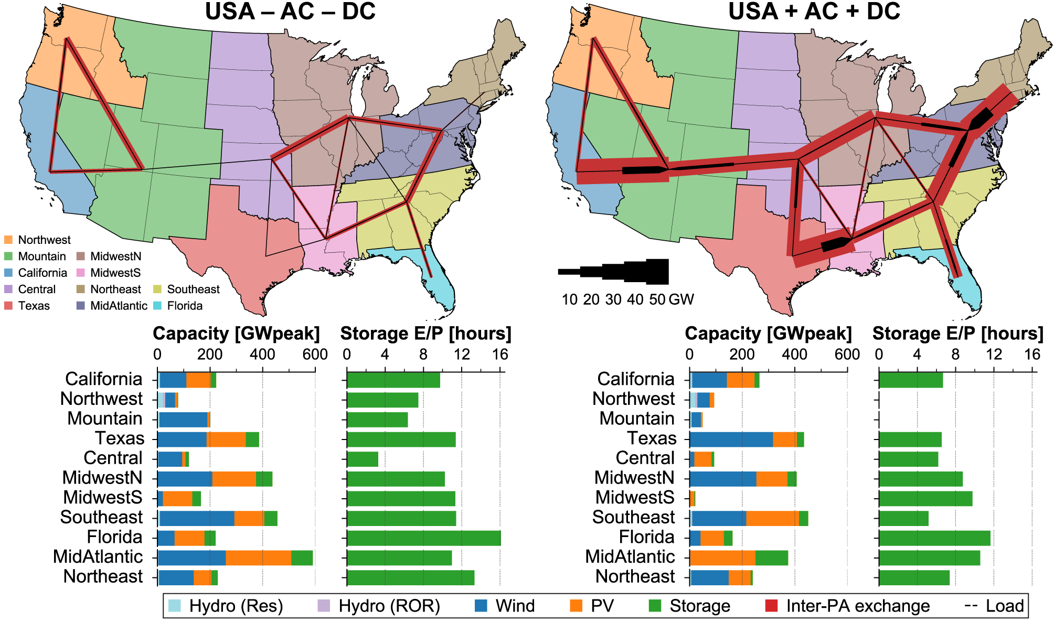
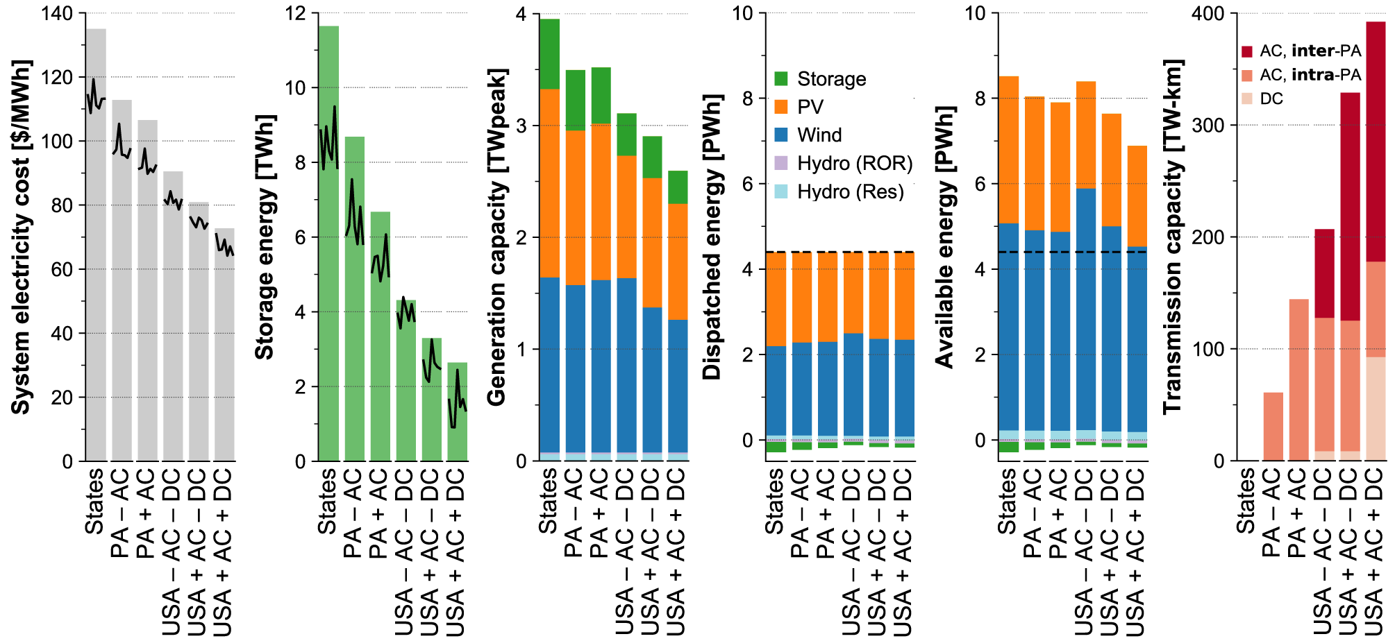
Two main benefits of inter-state transmission*
1. Reduction in aggregate variability through spatial averaging → Reduction in storage capacity + duration
2. Better access to high-quality resource regions → More energy from less PV/wind capacity
← demand
* Additional benefits of interregional transmission not resolved here:
n-1 security
Inertia / stability
Reduction in forecast uncertainty [Pfeifenberger 2020]
Sub-hourly balancing
Mitigating regionally-correlated unmodeled outages (e.g. icing, fuel scarcity)
Notes:
At a high level we can discern two major benefits of inter-state transmission.
First is a reduction in PV/wind variability through spatial averaging, which leads to a reduction in the storage capacity required (shown on the previous slide) and a reduction in the duration, or energy/power ratio, of storage that is deployed (from a peak of 16 hours in Florida in “USA – AC – DC” to a peak of 12 hours in “USA + AC + DC” and general reductions across all regions).
* The second benefit is better access to high-quality resource regions, such that you get more energy from less PV/wind capacity. You can see this by comparing the “planning-area” results with the first of the interconnected-US results:
* the total PV/wind capacity is smaller in “USA – AC – DC”, but the available energy (the capacity times the capacity factor) is higher, since that capacity is installed in higher-resource areas.
That’s one signal that we shouldn’t fixate too much on curtailment – in this case an increase in curtailment is associated with a decrease in both cost and installed capacity, which are the more important metrics.
* There are a number of additional benefits from transmission that we we don’t resolve in this study; these two are just the main ones we can see at our resolution.

Slide 9
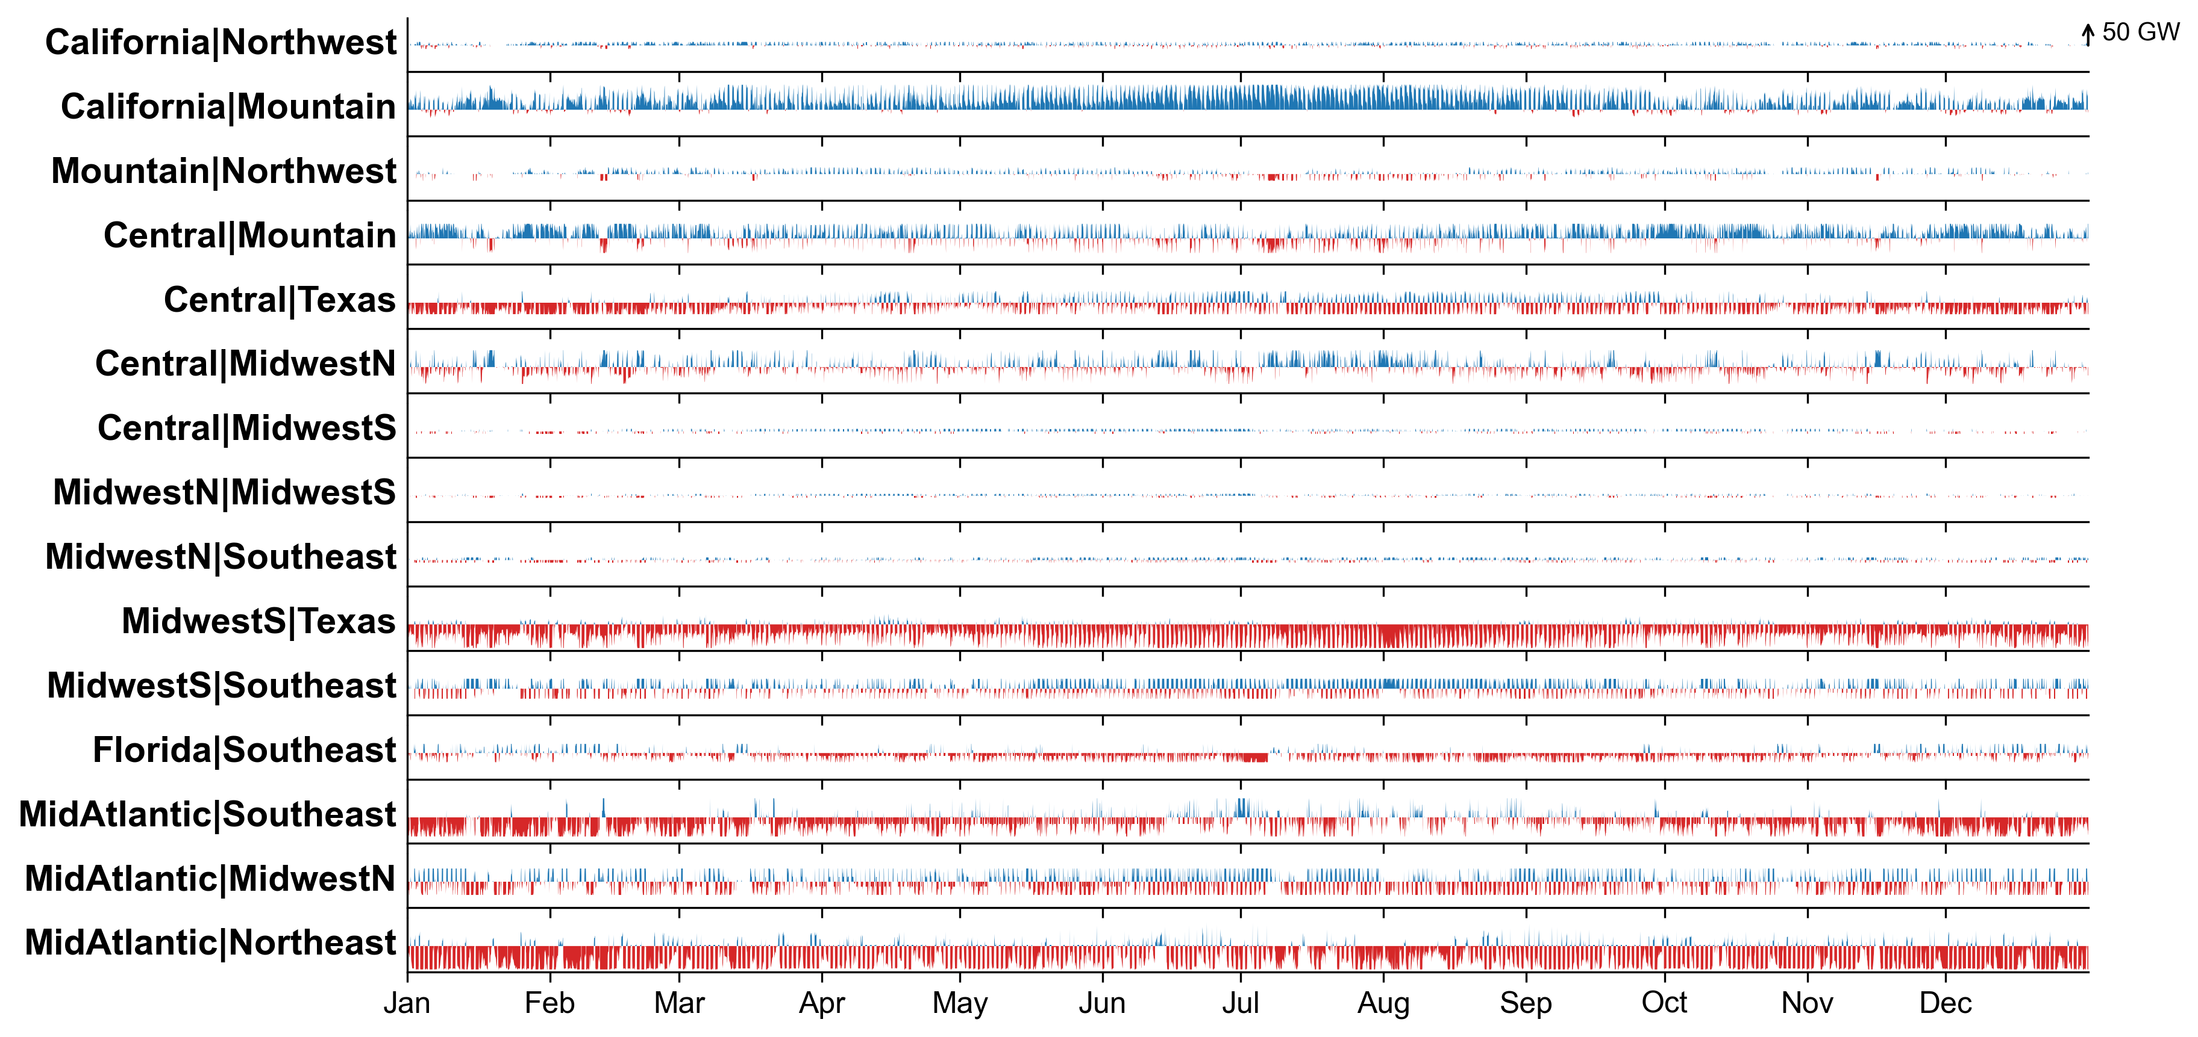
Flexible operation of interregional transmission
USA + AC + DC scenario
Modeled 2040 flows with 2010 weather

Slide 10
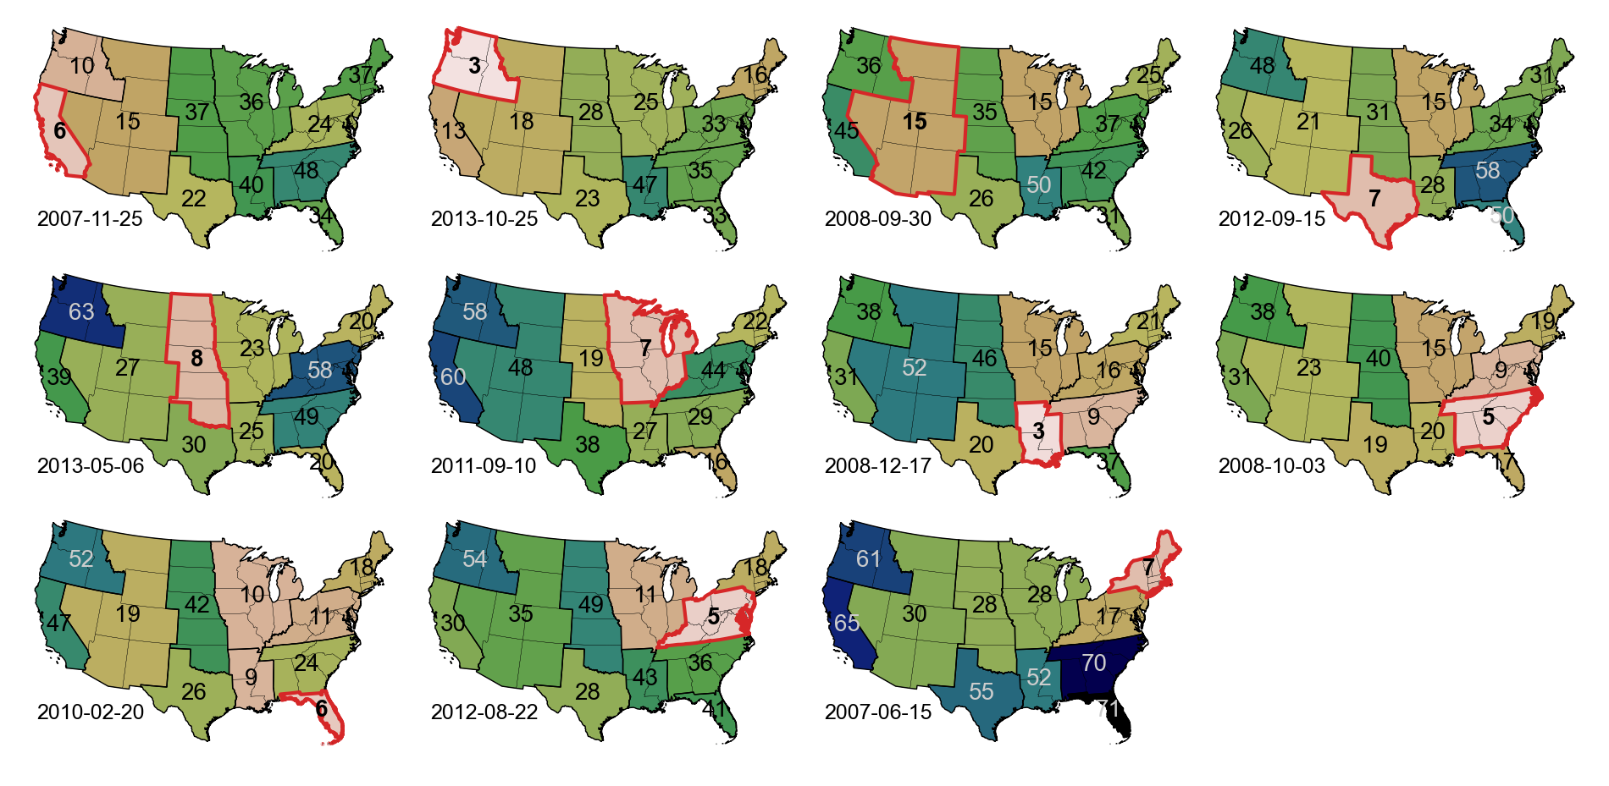
It’s always windy or sunny somewhere
Take the least-windy day in each planning area from 2007–2013.
How windy are each of the other planning areas on that day?
Single-day wind capacity factor [%]
at top quintile of sites

Slide 11
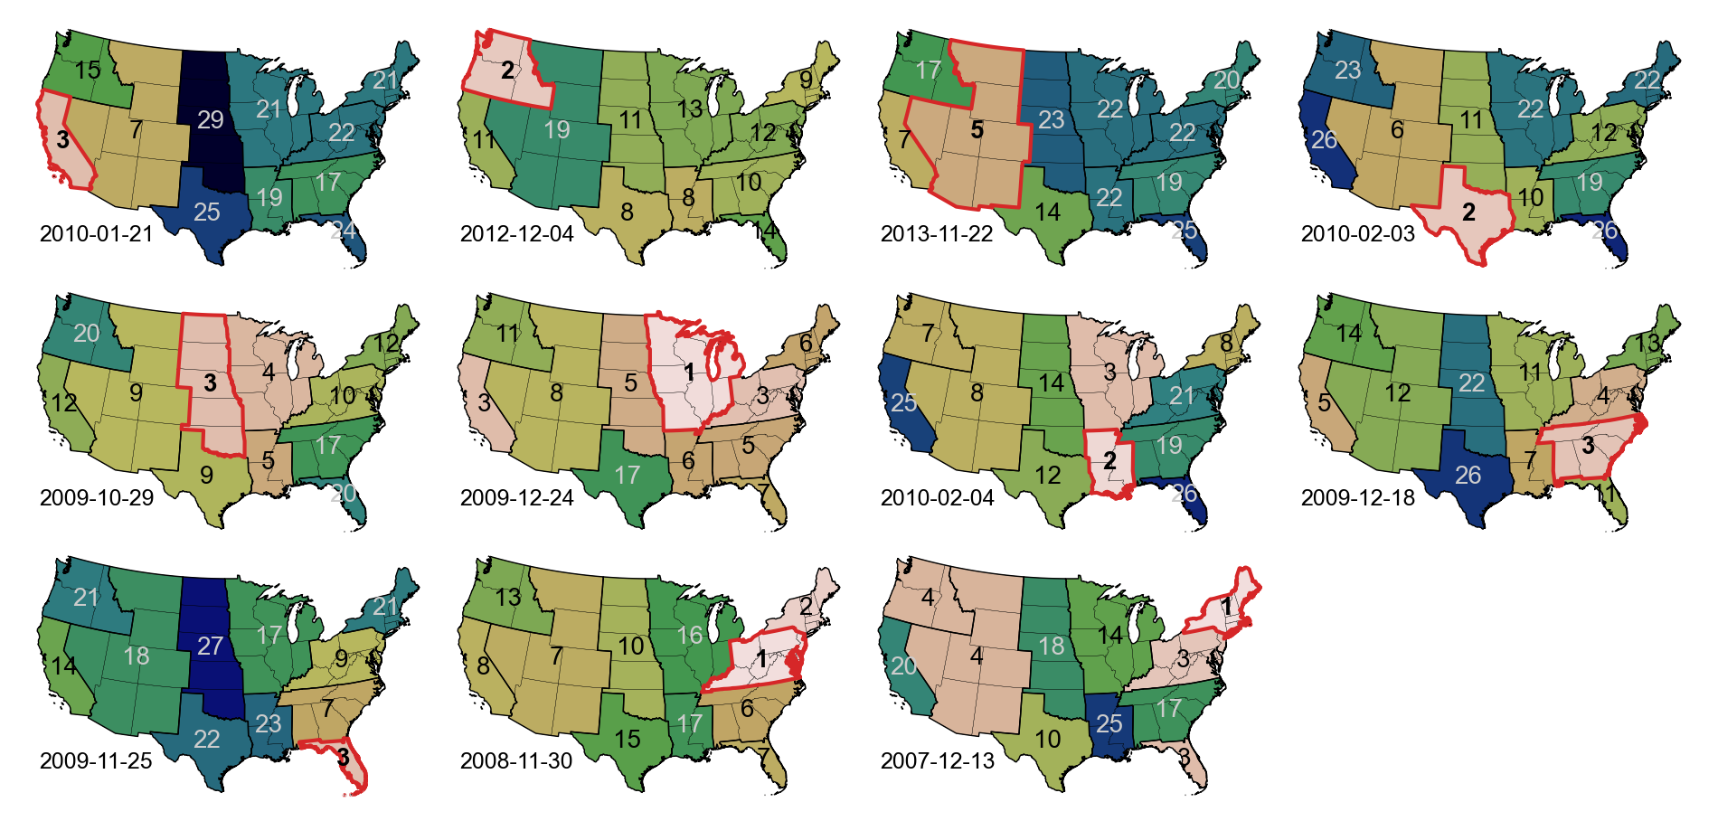
It’s always windy or sunny somewhere
Take the least-sunny day in each planning area from 2007–2013.
How sunny are each of the other planning areas on that day?
Single-day PV capacity factor [%]
at top quintile of sites

Slide 12
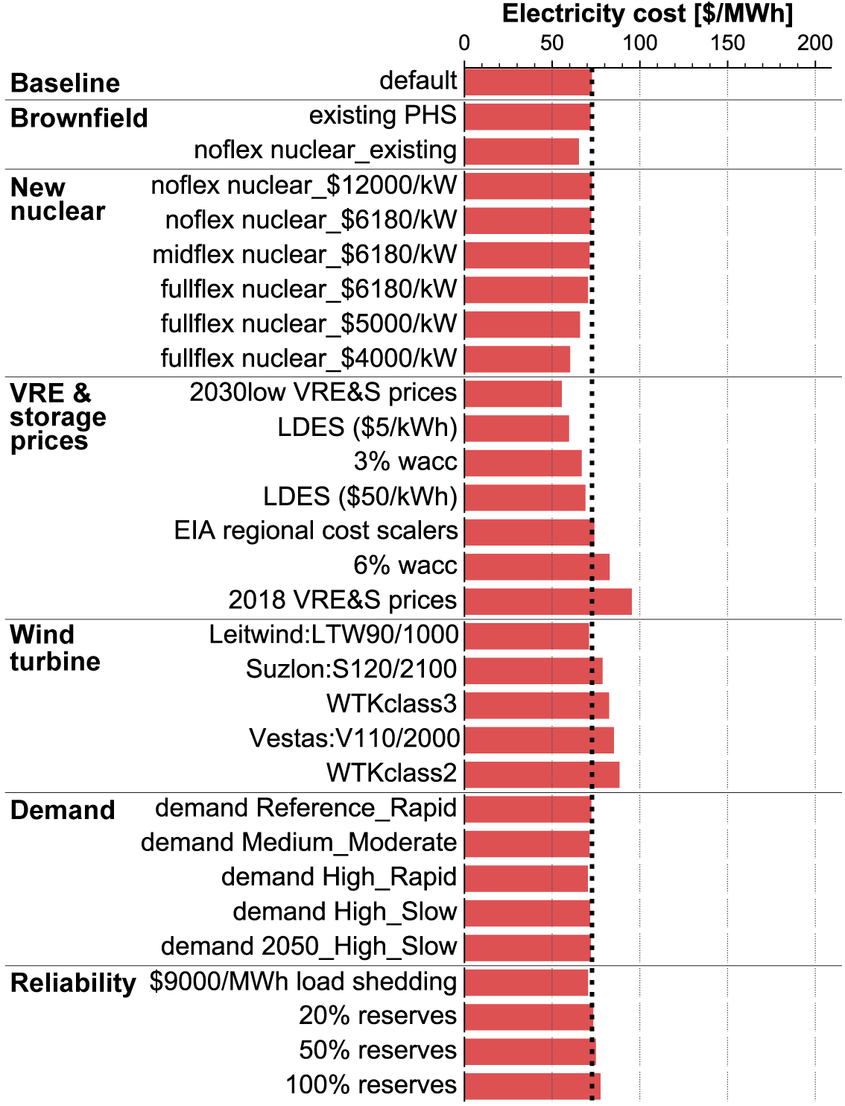
Sensitivity analysis: New interregional transmission allowed
Notes:
The results I’ve presented so far are for a single set of central assumptions, but there’s a lot of uncertainty in how these parameters may evolve over the next 20 years.
Here we take these same metrics and compare them across a range of sensitivity cases, on this slide focusing on the intergrated-US scenario allowing new interregional transmission.
* Including existing nuclear reduces the electricity cost,
* but new nuclear at central cost projections (~$6180/kW, from the NREL ATB) doesn't have much effect. (The Vogtle plant is more like $12000/kW, and none is built at that price.)
* Nuclear costs have to fall to $4000-5000/kW to have a large impact.
* The three cheapest scenarios are $4000/kW flexible nuclear, $5/kWh long-duration storage, and 2030 "low" PV/wind/Li-ion costs.
* I don't have much time to discuss it here, but the wind technology assumptions are quite important; we use a low-windspeed 200W/m^2 model and get much lower costs and storage deployment than using an older higher-windspeed model.
* Increasing the amount of electrification increases the capacity deployed, but doesn't have much impact on electricity price, since you're spreading it out over more MWh.
* We leave reserves out of most scenarios, but even if you include a very high reserve constraint it doesn’t have much impact on cost; because there’s so much storage and renewable curtailment on the system, you almost always have more energy than you need.

Slide 13
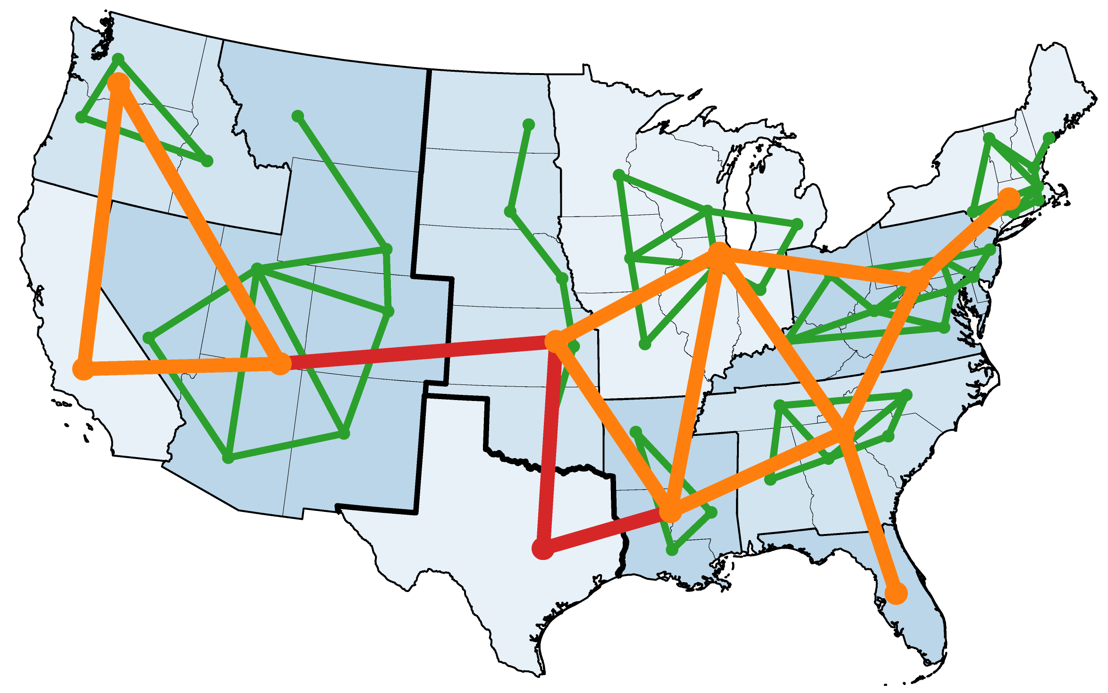
Sensitivity analysis: Limited transmission
Interstate transmission included:
+ New interregional across interconnects
+ New interregional within interconnects
+ Existing interregional
+ New regional
+ Existing regional
None
Notes:
That’s for the case allowing interregional transmission expansion.
But of course, our ability to expand transmission at these levels isn’t certain – there are currently major barriers to interregional expansion along the lines shown here.
So we can look at this sensitivity analysis as the ability to add new transmission is steadily reduced.

Slide 14
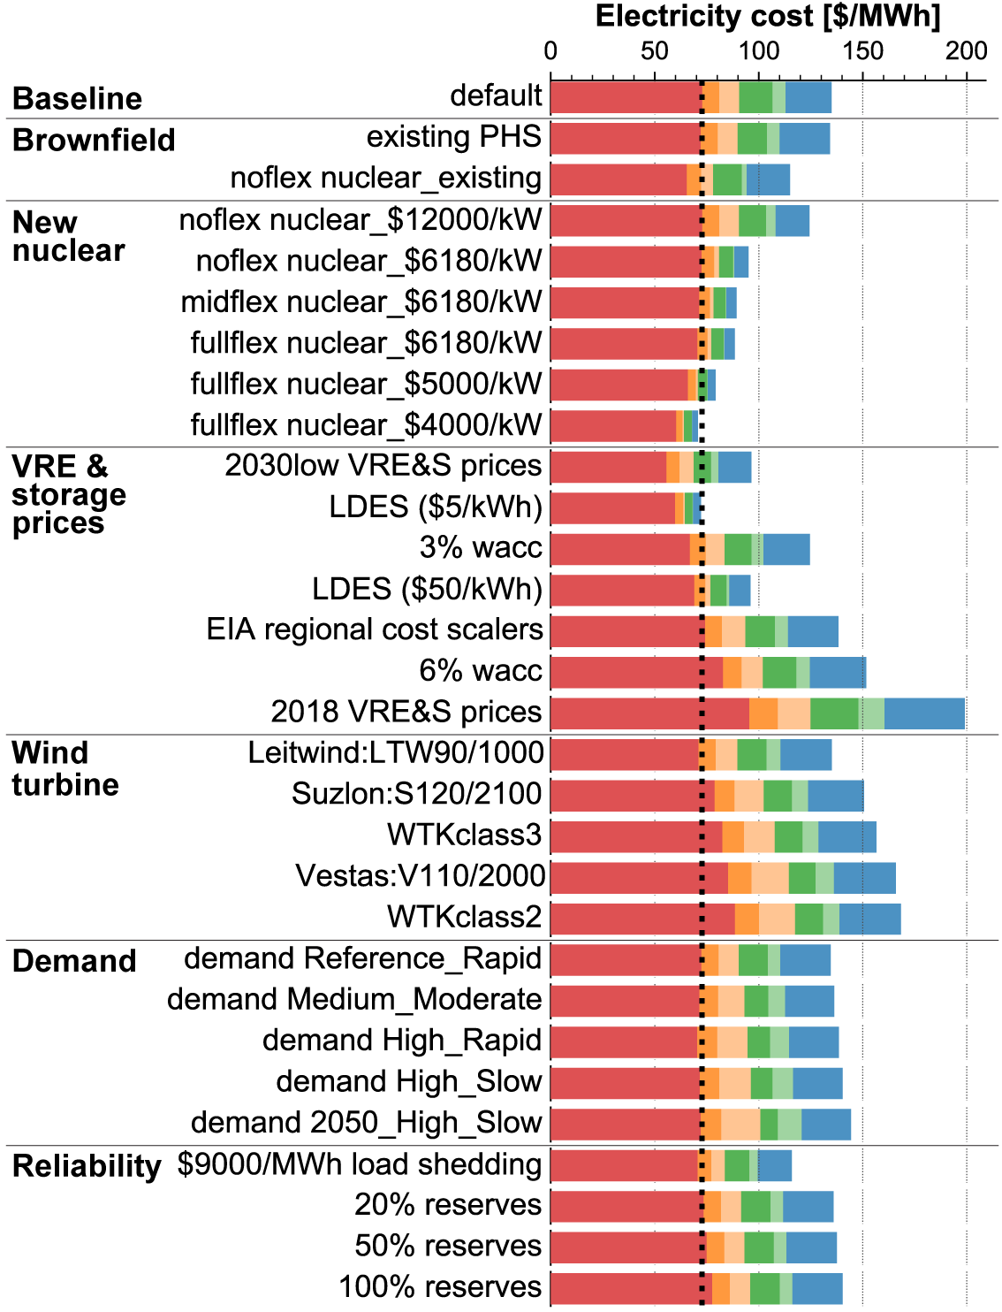
Sensitivity analysis: Limited transmission
Interstate transmission included:
+ New interregional across interconnects
+ New interregional within interconnects
+ Existing interregional
+ New regional
+ Existing regional
None
Lowest SCOE overall:
ATB₂₀₁₉ “low”* costs for PV, wind, Li-ion
New interregional transmission allowed
Lowest SCOE without new inter-state transmission:
$4000/kW new flexible nuclear
or
$5/kWh long-duration energy storage
→ Multiple potential paths to low-cost zero-carbon systems for the US
Notes:
Constraining interstate transmission uniformly increases the electricity cost, but to a different degree in the different scenarios.
As mentioned on the last slide, the lowest electricity cost overall is found in the case allowing new interregional transmission (gray bar) and assuming ATB 2030 "low" cost projections for PV, wind, and Li-ion.
*** Note that future costs for renewables tend to be overestimated. In fact, the “low” costs we use for PV and wind from NREL’s Annual Technology Baseline 2019 are actually higher than the “mid” cost estimates in ATB 2021.
* If new interstate transmission deployment is not allowed (colored bars), the $4000/kW nuclear and $5/kWh long-duration energy storage cases deliver the lowest electricity cost.
That explains how studies performed at different geographic scopes and with different transmission assumptions can reach different conclusions on the value of long-duration storage and other flexible resources.
* But it also emphasizes that there are multiple potential paths to low-cost zero-carbon electricity systems for the US.
(The dotted line at 70 $/MWh indicates the approximate LCOE of coal, assuming that "cheaper than coal" counts as “low-cost”.)
Shouldn’t say that LDES or nuclear, or any one piece (besides wind+solar) are “required”; we can cover the last 10% with a range of options.
None of these are easy! Building transmission and nuclear aren’t easy, and developing new transport networks for H2 or CO2 and bringing these new techs from demonstration to market aren’t easy.
But there are options using technologies currently being deployed at GW scale today,
there are multiple ways to address the last 10%,
and there’s lots of agreement that the first 80-90% are dominated by building lots of solar + wind.

Slide 15
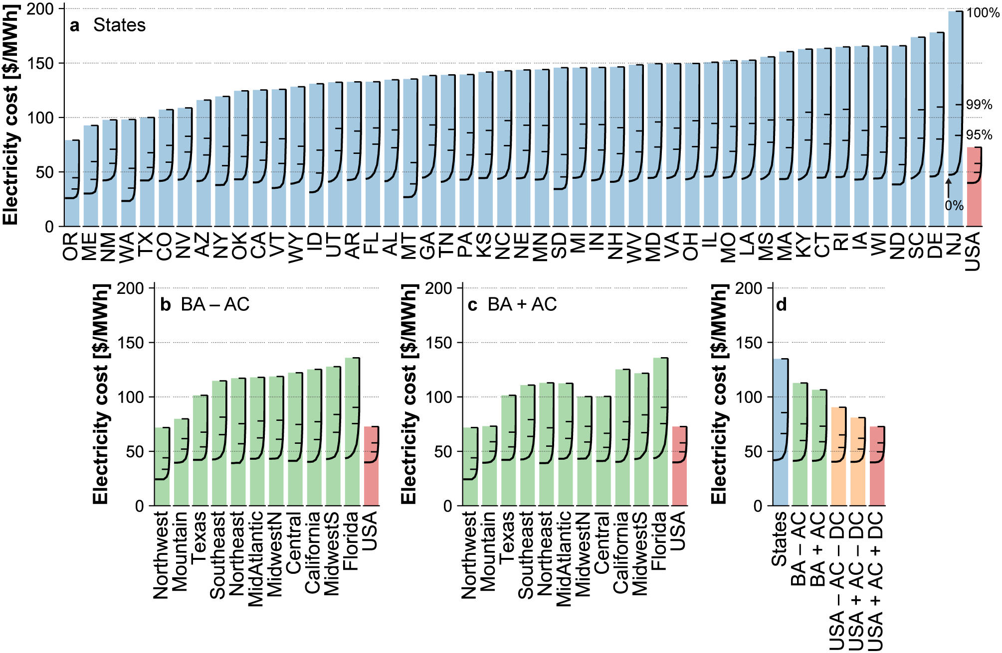
Lower decarbonization costs for interconnected system
Isolated states
Bars: 100% CES, full 2007-2013
Lines: 0% (left) to 100% (right) CES
Electricity cost increases significantly on approach to zero carbon for individual states,
but to a much smaller extent for full-US system
– ticks: 95%, 99%, 100% CES
Reaching 95% for the full US with new interregional transmission adds ~$10/MWh to no-policy cost
Notes:
The last point I’ll make is that while costs do increase nonlinearly as the system approaches 100% renewable, the cost of the last few percent is much smaller when interregional coordination and transmission expansion is allowed.
In this plot we’re again showing the system cost of electricity for the isolated-States scenario, but here they’re overlaid with the costs for sub-100% clean-energy standards, with 0% on the left, 100% on the right, and 95, 99, and 100% shown by the three tick marks.
Natural gas CCGT fills the gap in the sub-100% cases.
For isolated states, the last 1% is super expensive – for some states, going from 99% to 100% renewable doubles the cost.
* If we compare that to the full interconnected US system allowing interregional coordination and transmission, there’s still a nonlinear increase in cost, but it’s much smaller (and you can get to 95% with only about a 10 $/MWh, or 1 ¢/kWh, increase in cost).
* Reaching 100% renewable for the full US is roughly as expensive as reaching 95% renewable using an every-state-for-themselves approach.
Incremental cost of 95%, 99%, 100% RPS compared to no policy:
States: +24 $/MWh, +44 $/MWh, +93 $/MWh
USA: +10 $/MWh, +18 $/MWh, +33 $/MWh

Slide 16
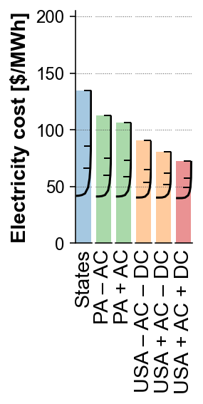
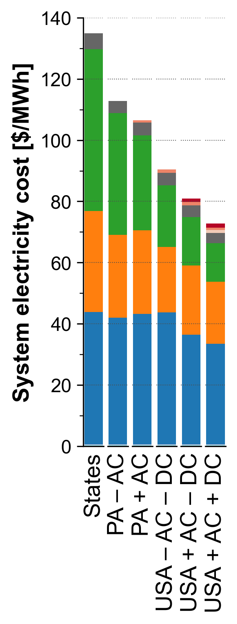
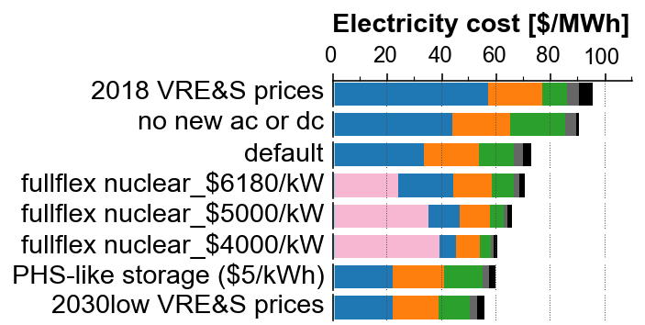
Primary findings
Inter-regional transmission significantly reduces costs and storage needs in high-VRE systems
Interannual variability is important, especially for isolated systems
Zero-carbon electricity system for contiguous US is feasible with today’s tech at 1-hour multi-year resolution
Decarbonization costs are significantly lower for integrated US-scale system than for isolated states
Nuclear and long-duration storage have the potential to reduce system cost, but are not required; reduction in VRE + Li-ion prices has a larger impact on system cost
Thanks to many for helpful discussions (errors and opinions are mine):
A. Botterud, H. Pfeifenberger,
H. Gruenspecht, P. Joskow,
R. Schmalensee, D. Mallapragada,
R. Stoner, J. Jenkins, N. Sepulveda,
Future of Storage team
https://doi.org/10.1016/j.joule.2020.11.013
prbrown@mit.edu
Notes:
In summary, we’ve seen that a zero-carbon electricity system for the contiguous US is feasible over multiple years at hourly resolution,
* and that inter-regional coordination and transmission construction significantly reduces the cost.
* Nuclear and “long-duration” (pumped-hydro-like) energy storage have the potential to reduce electricity costs—particularly in scenarios where transmission expansion isn’t allowed—but they aren’t required, and the combination of low-cost wind, PV, and Li-ion plus transmission expansion yields the lowest cost across all sensitivity cases studied.
* Overall, we’ve seen that decarbonization costs are significantly lower for an integrated US system than for isolated states or regions.
That isn't really a new conclusion, but it's good to note just how large the benefits are, even when lots of energy storage is available.

